Slide 1

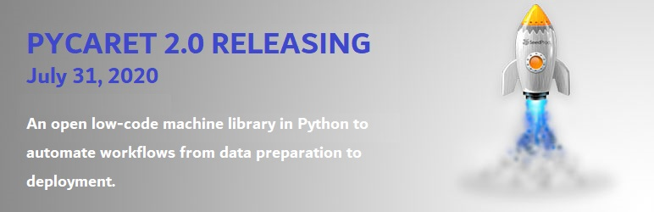
Introducing PyCaret 2.0
July 28, 2020

Slide 2





About me
Data Analytics Leader by day and passionate Data Scientist by night
Active open-source contributor
Member of CPA, CMA, Canada and ACMA, UK, CGMA
Lived and worked in Asia, Middle East, East Africa, North America
Currently based in Toronto, Canada
https://www.linkedin.com/in/profile-moez/
https://medium.com/@moez_62905/
https://twitter.com/moezpycaretorg1
moez@pycaret.org

Slide 3
Important Links
Official : https://www.pycaret.org
PyCaret GitHub : https://www.github.com/pycaret/pycaret
LinkedIn : https://www.linkedin.com/company/pycaret
YouTube : https://www.youtube.com/channel/UCxA1YTYJ9BEeo50lxyI_B3g
Medium : https://medium.com/@moez_62905/
Today’s Presentation and Demo : https://www.github.com/pycaret/pycaret-demo-td
Follow hashtag #pycaret on LinkedIn and Twitter

Slide 4
Agenda
What is PyCaret?
Demo
Use-case: Insurance Charges Prediction
→ Develop machine learning pipeline using PyCaret
→ Build web service and front-end using Flask
→ Containerize it using Docker
→ Deploy it as a web service on Microsoft Azure
Questions?

Slide 5
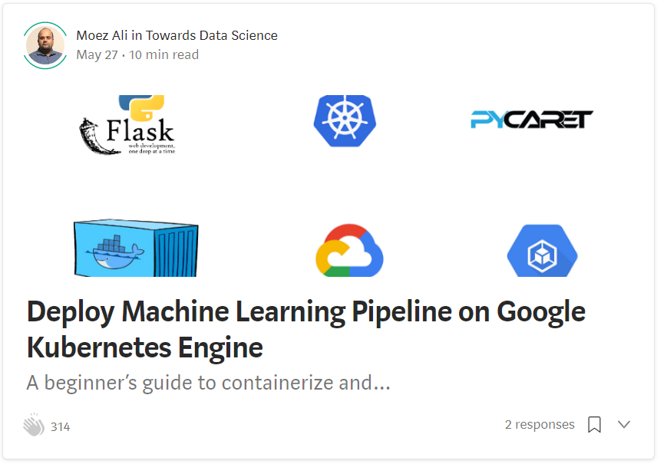
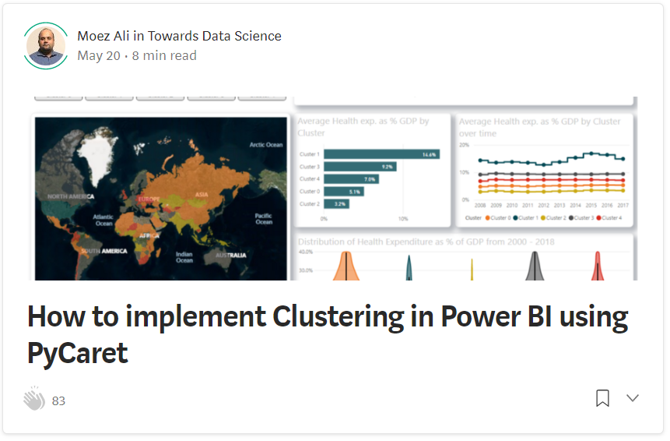
Resources
https://towardsdatascience.com/deploy-machine-learning-model-on-google-kubernetes-engine-94daac85108b
https://towardsdatascience.com/how-to-implement-clustering-in-power-bi-using-pycaret-4b5e34b1405b

Slide 6
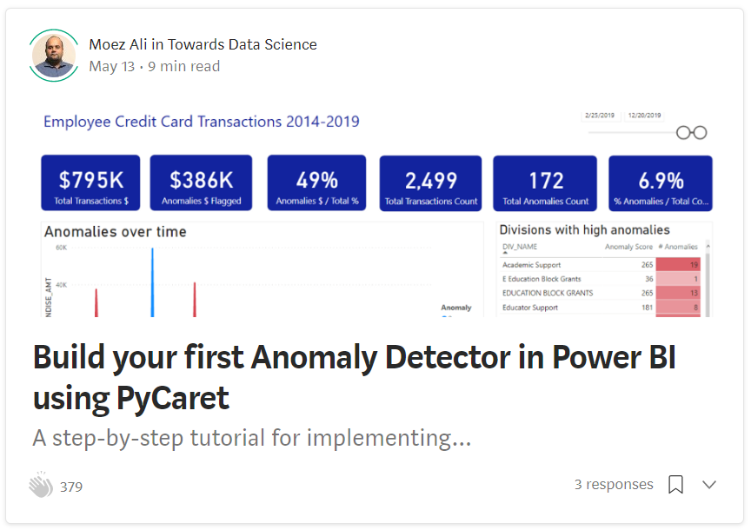
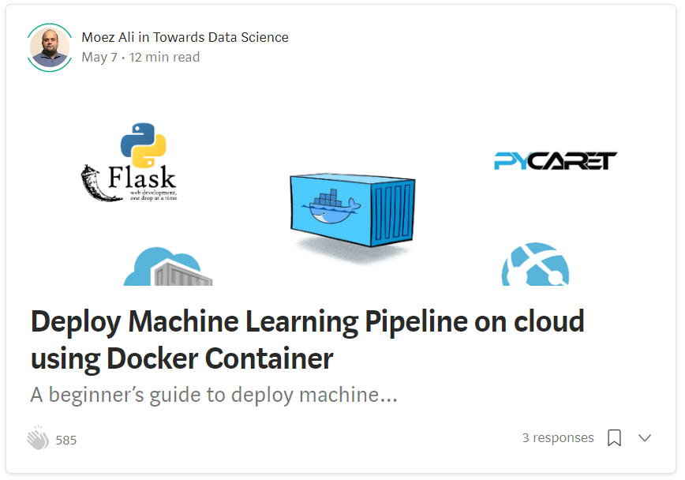
Resources (cont.)
https://towardsdatascience.com/build-your-first-anomaly-detector-in-power-bi-using-pycaret-2b41b363244e
https://towardsdatascience.com/deploy-machine-learning-pipeline-on-cloud-using-docker-container-bec64458dc01

Slide 7
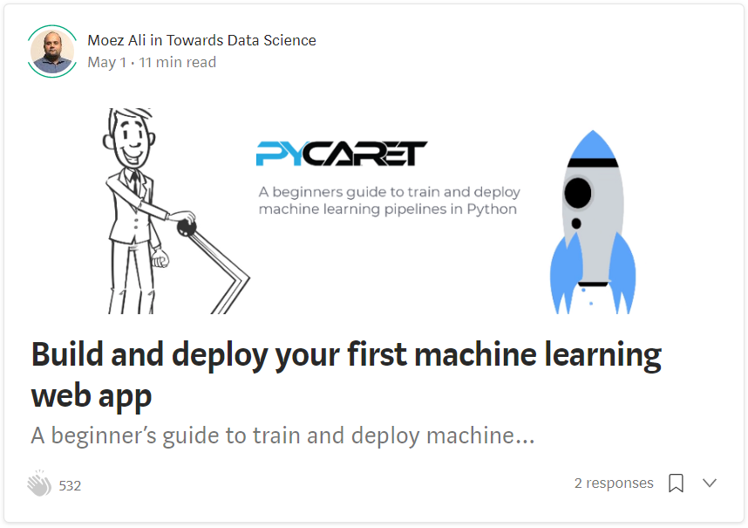
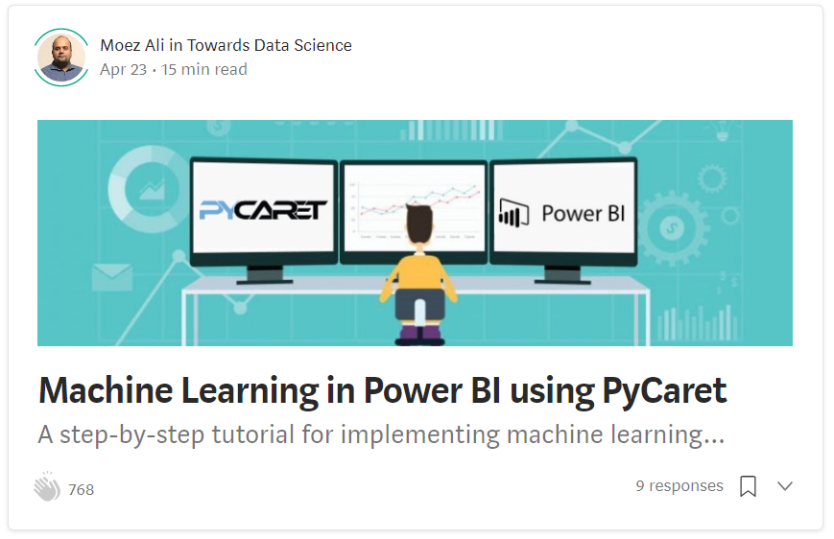
Resources (cont.)
https://towardsdatascience.com/build-and-deploy-your-first-machine-learning-web-app-e020db344a99
https://towardsdatascience.com/machine-learning-in-power-bi-using-pycaret-34307f09394a

Slide 8
Resources (cont.) – Official Video Tutorials
Binary Classification Video Tutorial
https://www.youtube.com/watch?v=2xAgLKUN6Xs
Clustering in PyCaret Video Tutorial
https://www.youtube.com/watch?v=2oxLDir7foQ
Anomaly Detection in PyCaret Video Tutorial
https://www.youtube.com/watch?v=q0dxYDq1A40&t=2s
Topic Modeling in PyCaret Video Tutorial
https://www.youtube.com/watch?v=G6ShuoM3T1M
Association Rule Mining in PyCaret Video Tutorial
https://www.youtube.com/watch?v=XYAGwts5qGw

Slide 9
Resources (cont.)
Machine Learning in SQL by Umar Farooque
https://towardsdatascience.com/machine-learning-in-sql-using-pycaret-87aff377d90c
PyCaret’s integration with Tableau by Andrew Cowan-Nagora
https://towardsdatascience.com/machine-learning-in-tableau-with-pycaret-166ffac9b22e
NLP Classification using PyCaret by Prateek Baghel
https://towardsdatascience.com/predicting-crashes-in-gold-prices-using-machine-learning-5769f548496
Predict Gold Price Returns using PyCaret by Riazuddin Mohammad
https://towardsdatascience.com/machine-learning-to-predict-gold-price-returns-4bdb0506b132
Predict Crashes in Gold Price using PyCaret by Riazuddin Mohammad
https://towardsdatascience.com/predicting-crashes-in-gold-prices-using-machine-learning-5769f548496

Slide 10
Resources (cont.)
Binary Classification Notebook by Murali Tedla
https://colab.research.google.com/drive/1W6ZYw5oAN7V85utFkXkCQq3iBWjqP1WB
Wine Quality Prediction by Abhinav Arora
https://colab.research.google.com/drive/1uFNmhgM9ghVrtqN3MXaofxDlLePb3yIi#scrollTo=sYsHyY8uH6tb
Build your machine learning models by Lakshay Arora
https://www.analyticsvidhya.com/blog/2020/05/pycaret-machine-learning-model-seconds/
PyCaret’s Integration with Power BI (1 Hour Video Tutorial)
https://www.youtube.com/watch?v=ZeQVkEWo2x0
Anomaly Detection using PyCaret by Krish Naik (Video Tutorial)
https://www.youtube.com/watch?v=ZeQVkEWo2x0

Slide 11
Let’s get started

Slide 12

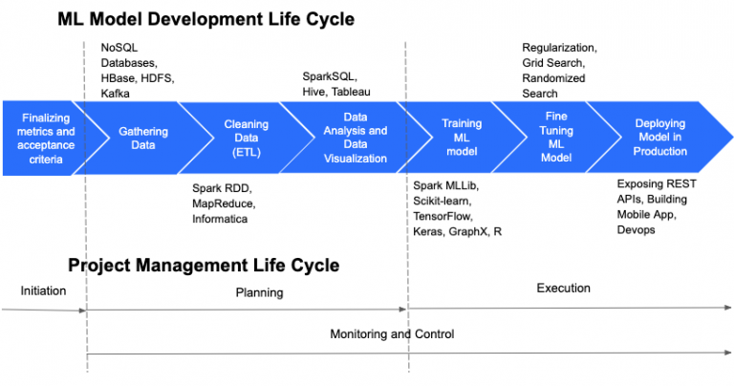
https://cloudxlab.com/blog/things-to-consider-while-managing-machine-learning-projects/machine-learning-and-project-management-life-cycle-2/

Slide 13
Granular ML Life Cycle
Business Problem
Define ML Objective
Collect Data
Analyze
Train Test Split
Handle Datatypes
Impute Missing Values
… zillion other things
Feature Selection
Feature Interaction
Feature Engineering
Transformations
Scaling
Encodings
REPEAT
Model Training
Cross Validation
Track Performance
Hyperparameter tuning
Track Performance
Ensemble Model
Track Performance
Deploy Model
… zillion other things
Analyze Plots
Track Performance
Stack Models
Track Performance
Blend Models

Slide 14



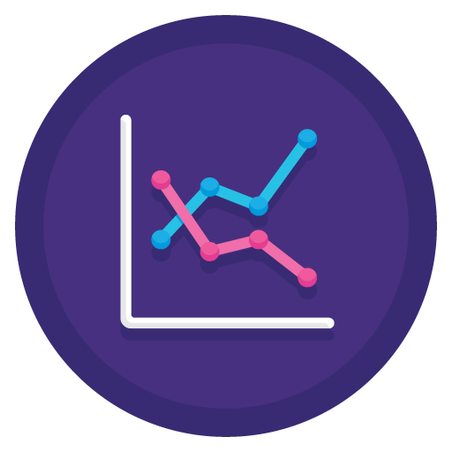

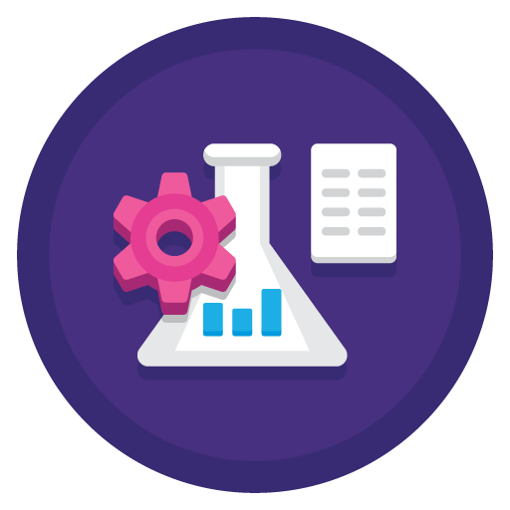
PyCaret can help you with:
Data
Preparation
Model
Training
Hyperparameter
Tuning
Analysis &
Interpretability
Model
Selection
Experiment
Logging

Slide 15
Machine Learning use-case supported:
Classification
Regression
Clustering
Anomaly Detection
Natural Language Processing
Association Rule Mining
Time Series Module in development

Slide 16



What is PyCaret?
PyCaret is an open source, low-code machine learning library and end-to-end model management tool created to help you automate your machine learning workflows in Python. It is commonly used for rapid prototyping and deployment of ML pipelines.
EASY TO USE
PRODUCTIVITY TOOL
BUSINESS READY

Slide 17
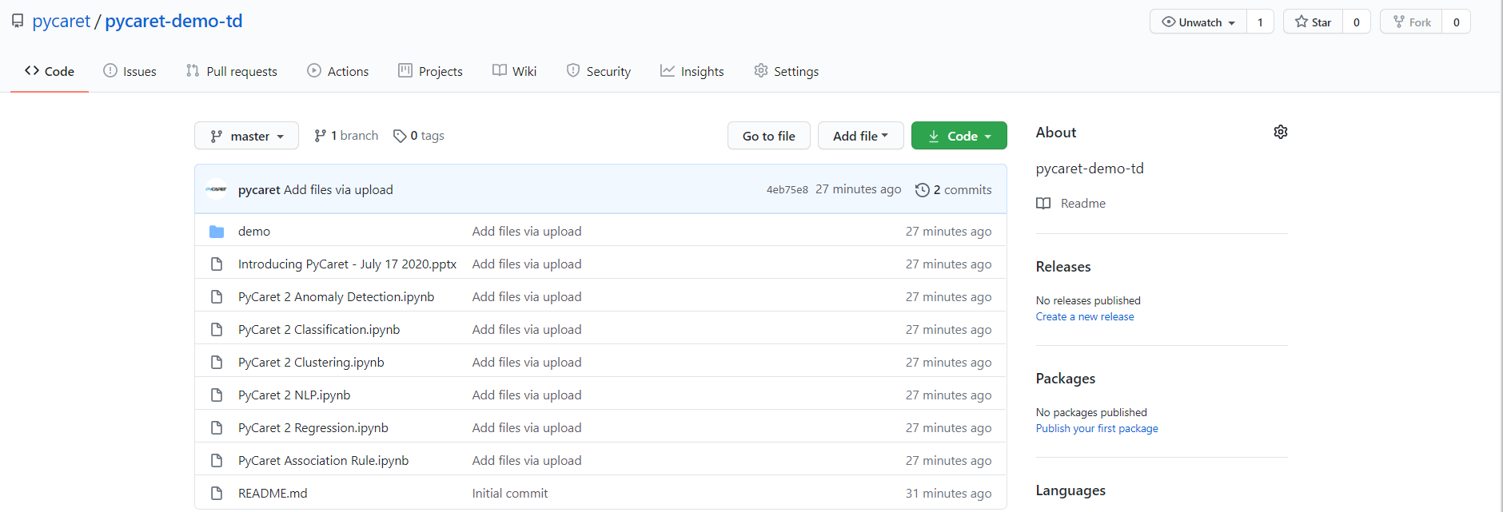
Demo 1 – Feature Preview
Clone repository from https://github.com/pycaret/pycaret-demo-td
Install PyCaret by running "pip install pycaret-nightly" in Notebook or in Anaconda prompt
If you are using MAC OS, you might have to install LightGBM separately. Follow instructions on this link: https://www.pycaret.org/install

Slide 18
End of Demo 1

Slide 19
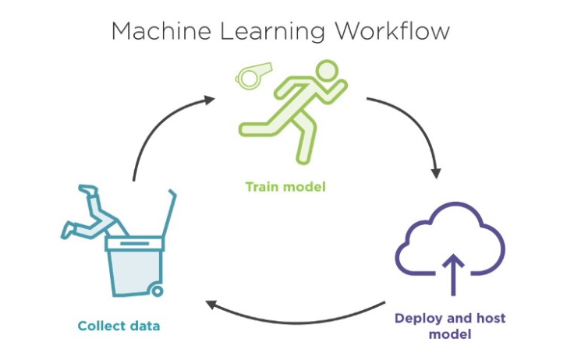
What is deployment?
The deployment of machine learning models is the process of making models available in production where web applications, enterprise software and APIs can consume the trained model by providing new data points and generating predictions.

Slide 20

What is a container?
The most intuitive way to understand containers is to think them as containers on a ship where the goal is to isolate the contents of one container from the others so they don’t get mixed up. This is exactly what containers are used for in data science.

Slide 21
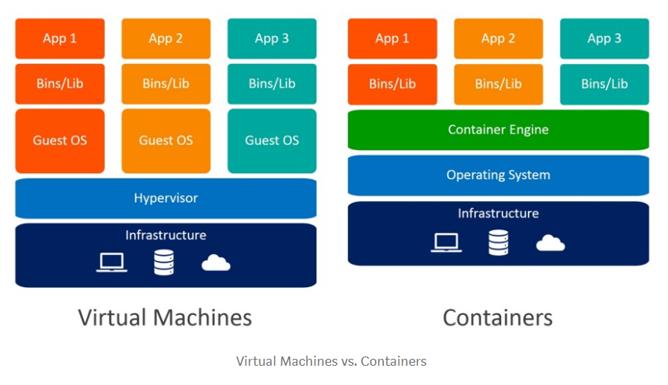
Why not just use virtual machines?

Slide 22

What is Docker?
Docker is a company that provides software (also called Docker) that allows users to build, run and manage containers. While Docker’s container are the most common, there are other less famous alternatives such as LXD and LXC that provides container solution.

Slide 23
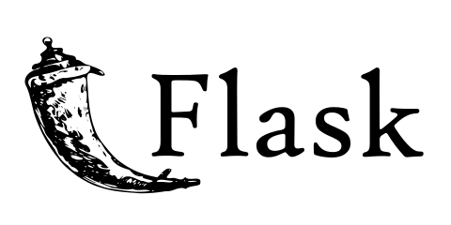
Flask
Flask is a web framework. This means flask provides you with tools, libraries and technologies that allow you to build a web application. This web application can be some web pages, a blog, a wiki or go as big as a web-based calendar application or a commercial website.

Slide 24
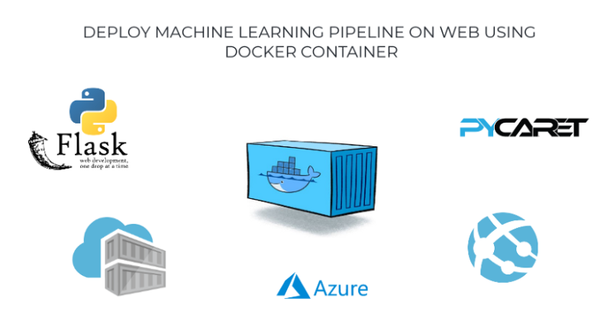
Demo 2 – Docker + Deployment
https://towardsdatascience.com/deploy-machine-learning-pipeline-on-cloud-using-docker-container-bec64458dc01

Slide 25
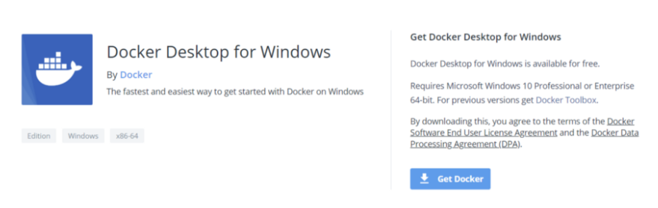
Install Docker Desktop for Windows
https://hub.docker.com/editions/community/docker-ce-desktop-windows/
For Windows Home : https://docs.docker.com/docker-for-windows/install-windows-home/

Slide 26
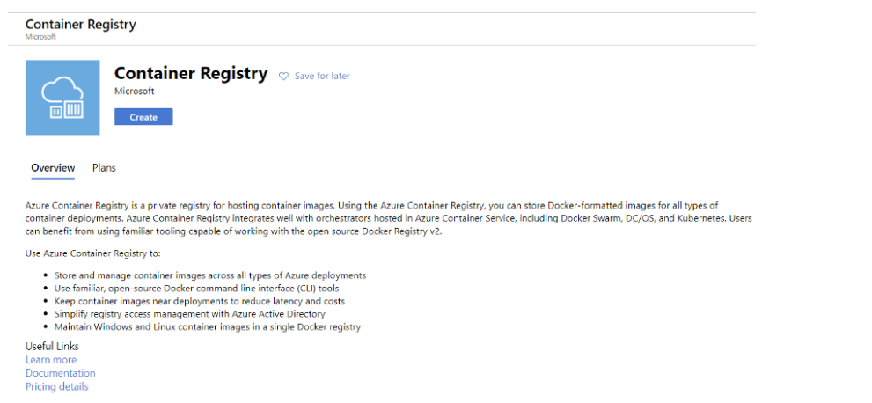
Create Container Registry

Slide 27
Build Docker Image
# build docker image
docker build -t tdbank.azurecr.io/pycaret-insurance:latest .
#run container locally
docker run -d -p 5000:5000 tdbank.azurecr.io/pycaret-insurance
#authenticate registry (one-time)
docker login tdbank.azurecr.io
#push image to registry
docker push tdbank.azurecr.io/pycaret-insurance:latest

Slide 28
Thank you
Questions?

